Slide 1
Exercise 3.2 Image classification Group 1
Mehdin Masinovic (Student ID: 11713301)
Fardokhtsadat Mohammadi (Student ID: 01655989)
Waldemar Schewzow (Student ID: 12102485)

Slide 2
Task description
Color histograms
SIFT + Visual Bag of Words
CNN

Slide 3
Datasets
Fashion MNIST:
Provided by Zalando as grey images (60000 train, 10000 test)
To replace old handwritten-digits dataset, more difficult to extract features
10 classes: shoes, pants, skirts, ...
Labelled faces in the wild:
Provided by scikit-learn (3024 rows)
Only people used that have at least 20 images
Used to recognize different people, every person is one class (42 classes)

Slide 4
Color Histograms
Idea:
For every image, use brightness in pixels to compute histogram (0-255)
Grey images have one channel (0=black, 255=white), whereas colorful images have three (red, green, and blue)
Split data into training and test sets
Train models, apply on the test set, and measure and compare performance of models

Slide 5
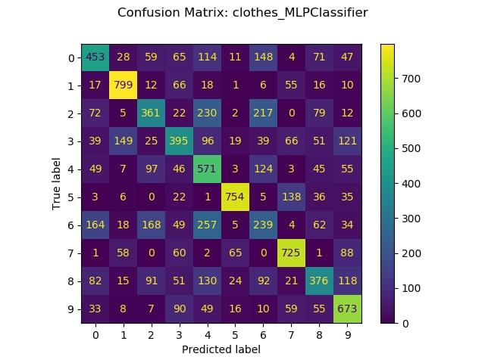
Color Histogram – Fashion MNIST – MLP – Activation Relu – Learning Constant – 3 Layers with 50, 100 and 50 Neurons
​Class Name | Precision​ | Recall​ | F1-score​
T-shirt/top​ | 0.50​ | 0.453​ | 0.47​
Trouser​ | 0.73​ | 0.799​ | 0.76​
Pullover​ | 0.44​ | 0.361​ | 0.40​
Dress​ | 0.46​ | 0.395​ | 0.42​
Coat​ | 0.39​ | 0.571​ | 0.46​
Sandal​ | 0.84​ | 0.754​ | 0.80​
Shirt​ | 0.27​ | 0.239​ | 0.25​
Sneaker​ | 0.67​ | 0.725​ | 0.70​
Bag​ | 0.47​ | 0.376​ | 0.42​
Ankle boot | 0.56​ | 0.673​ | 0.61​
Accuracy​ | 0.53​ | 0.5346​ | 0.53​

Slide 6
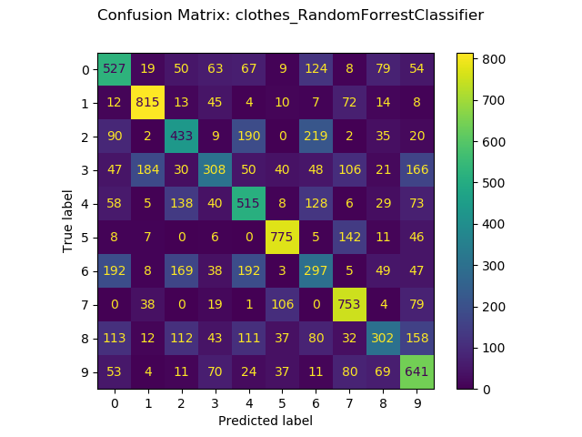
Color Histogram – Fashion MNIST – Random Forest – Max Depth 20 – Nr of Estimators 100
​Class Name | Precision​ | Recall​ | F1-score​
T-shirt/top​ | 0.48​ | 0.53​ | 0.50​
Trouser​ | 0.74​ | 0.81​ | 0.78​
Pullover​ | 0.45​ | 0.43​ | 0.44​
Dress​ | 0.48​ | 0.31​ | 0.37​
Coat​ | 0.45​ | 0.51​ | 0.48​
Sandal​ | 0.76​ | 0.77​ | 0.76​
Shirt​ | 0.32​ | 0.30​ | 0.31​
Sneaker​ | 0.62​ | 0.75​ | 0.69​
Bag​ | 0.50​ | 0.30​ | 0.37​
Ankle boot | 0.50​ | 0.64​ | 0.56​
Accuracy​ | 0.54​ | 0.54​ | 0.5366​

Slide 7
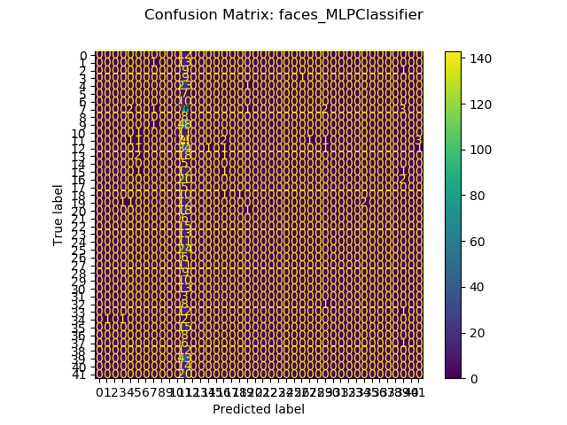
Color Histogram – Labelled Faced in The Wild – MLP –Activation Relu – Learning Constant – 1 Layer with 100 Neurons
Class Name | precision | recall | f1-score | support
Colin Powell | 0.33 | 0.012 | 0.02 | 85.0
George W. Bush | 0.19 | 0.94 | 0.31 | 152.0
Jack Straw | 1.0 | 0.083 | 0.15 | 12.0
accuracy | 0.18 | 0.18 | 0.18 | 0.18
George W. Bush: 530
Colin Powell: 236
Jack Straw: 28

Slide 8
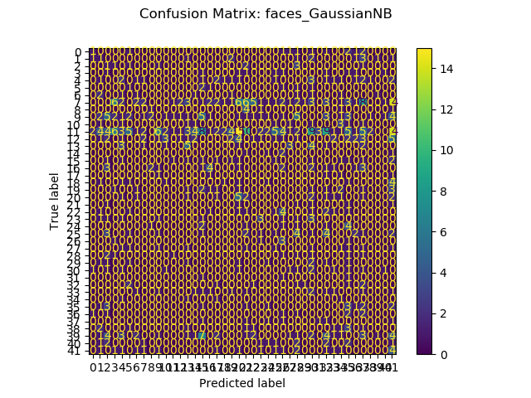
Color Histogram – Labelled Faced in The Wild – Naive Bayes with Default Parameters
Class Name | Precision | Recall | F1-score
0 | 0.17 | 0.08 | 0.11
1 | 0.04 | 0.07 | 0.05
2 | 0.03 | 0.1 | 0.04
4 | 0.08 | 0.08 | 0.08
5 | 0.05 | 0.14 | 0.08
6 | 0.10 | 0.1 | 0.09
7 | 0.18 | 0.02 | 0.04
8 | 0.17 | 0.12 | 0.14
11 | 0.2 | 0.006 | 0.01
12 | 0.2 | 0.02 | 0.04
13 | 0.22 | 0.23 | 0.22
15 | 0.03 | 0.07 | 0.04
16 | 0.31 | 0.18 | 0.23
18 | 0.2 | 0.08 | 0.12
20 | 0.12 | 0.263 | 0.16
23 | 0.23 | 0.23 | 0.23
25 | 0.06 | 0.04 | 0.05
26 | 0.10 | 0.5 | 0.17
28 | 0.03 | 0.11 | 0.05
30 | 0.04 | 0.15 | 0.06
33 | 0.08 | 0.077 | 0.08
34 | 0.05 | 0.25 | 0.087
35 | 0.07 | 0.2 | 0.10
39 | 0.33 | 0.02 | 0.04
41 | 0.06 | 0.2 | 0.09
Accuracy | 0.06 | 0.06 | 0.06

Slide 9
SIFT and BOVW
Idea:
Transform pixel information into descriptors
Descriptors offer a numerical representation of the image, which is invariant to the rotation, size, or angle of the image
Descriptors are clustered into similar features using K-means

Slide 10
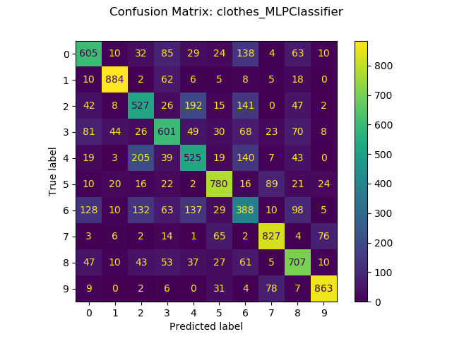
SIFT – Fashion MNIST – MLP – Activation Relu – Learning Constant – 1 Layer with 100 Neurons
​Class Name | Precision | Recall | F1-score
T-shirt/top​ | 0.63 | 0.60 | 0.62
Trouser​ | 0.89 | 0.88 | 0.89
Pullover​ | 0.53 | 0.53 | 0.53
Dress​ | 0.62 | 0.60 | 0.61
Coat​ | 0.54 | 0.52 | 0.53
Sandal​ | 0.76 | 0.78 | 0.77
Shirt​ | 0.40 | 0.39 | 0.39
Sneaker​ | 0.79 | 0.83 | 0.81
Bag​ | 0.65 | 0.71 | 0.68
Ankle boot | 0.86 | 0.86 | 0.86
Accuracy​ | 0.67 | 0.67 | 0.67

Slide 11
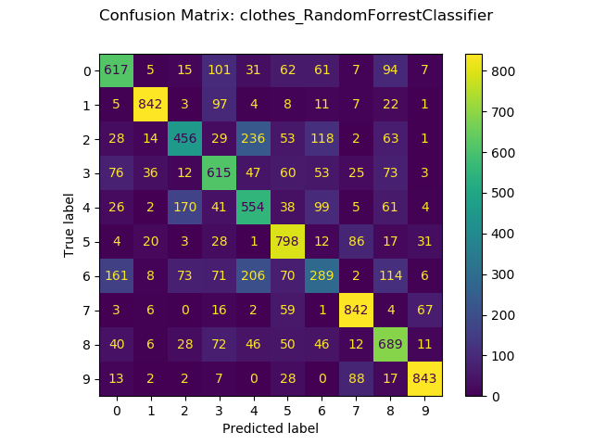
SIFT – Fashion MNIST – Random Forest – Max Depth 20 –Nr of Estimators 100
​Class Name | Precision | Recall | F1-score
T-shirt/top​ | 0.63 | 0.62 | 0.62
Trouser​ | 0.90 | 0.84 | 0.87
Pullover​ | 0.60 | 0.46 | 0.52
Dress​ | 0.57 | 0.61 | 0.60
Coat​ | 0.50 | 0.55 | 0.52
Sandal​ | 0.65 | 0.80 | 0.72
Shirt​ | 0.42 | 0.29 | 0.34
Sneaker​ | 0.78 | 0.84 | 0.81
Bag​ | 0.60 | 0.69 | 0.64
Ankle boot | 0.86 | 0.84 | 0.85
Accuracy​ | 0.65 | 0.65 | 0.65

Slide 12
SIFT – Labelled Faced in The Wild
Similar results to the color histogram approach:
Most models predict majority class only
Naïve Bayes offers best classification results

Slide 13
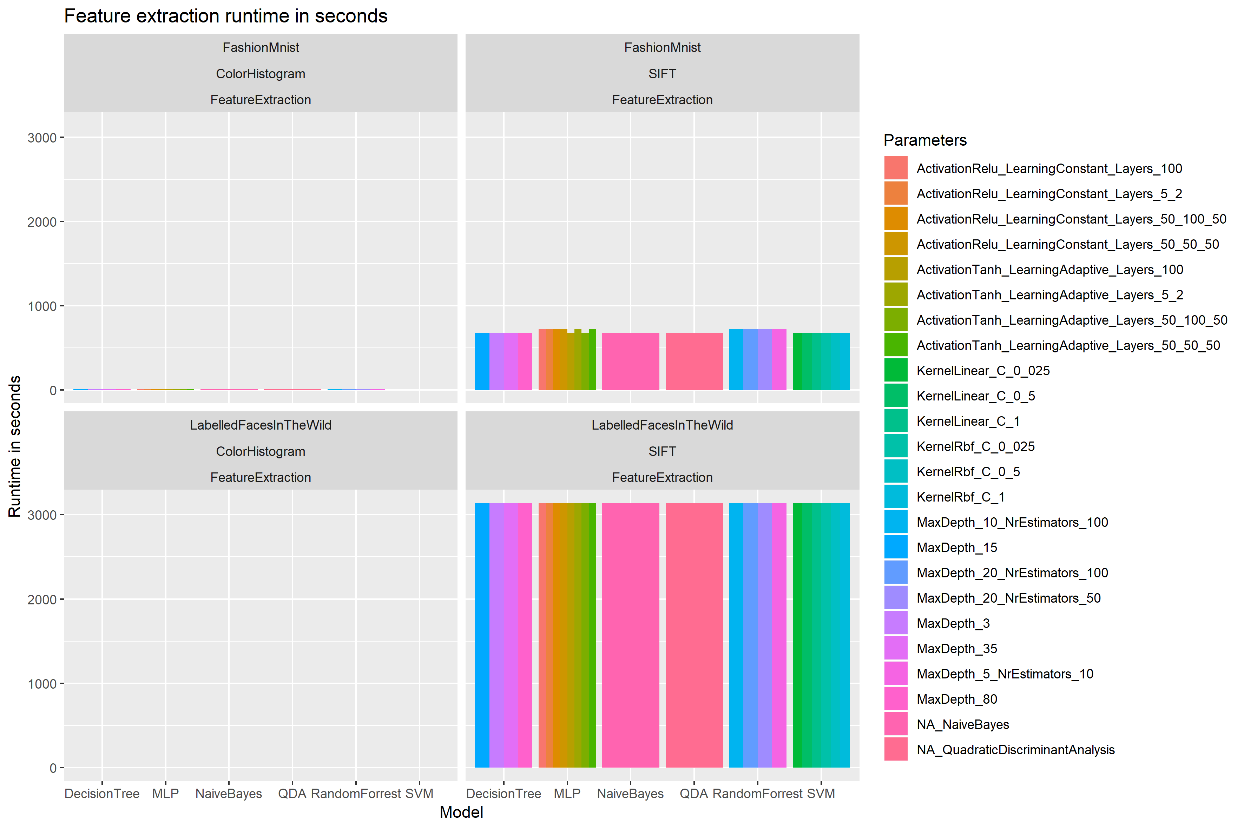
Time and Performance for Feature Extraction

Slide 14
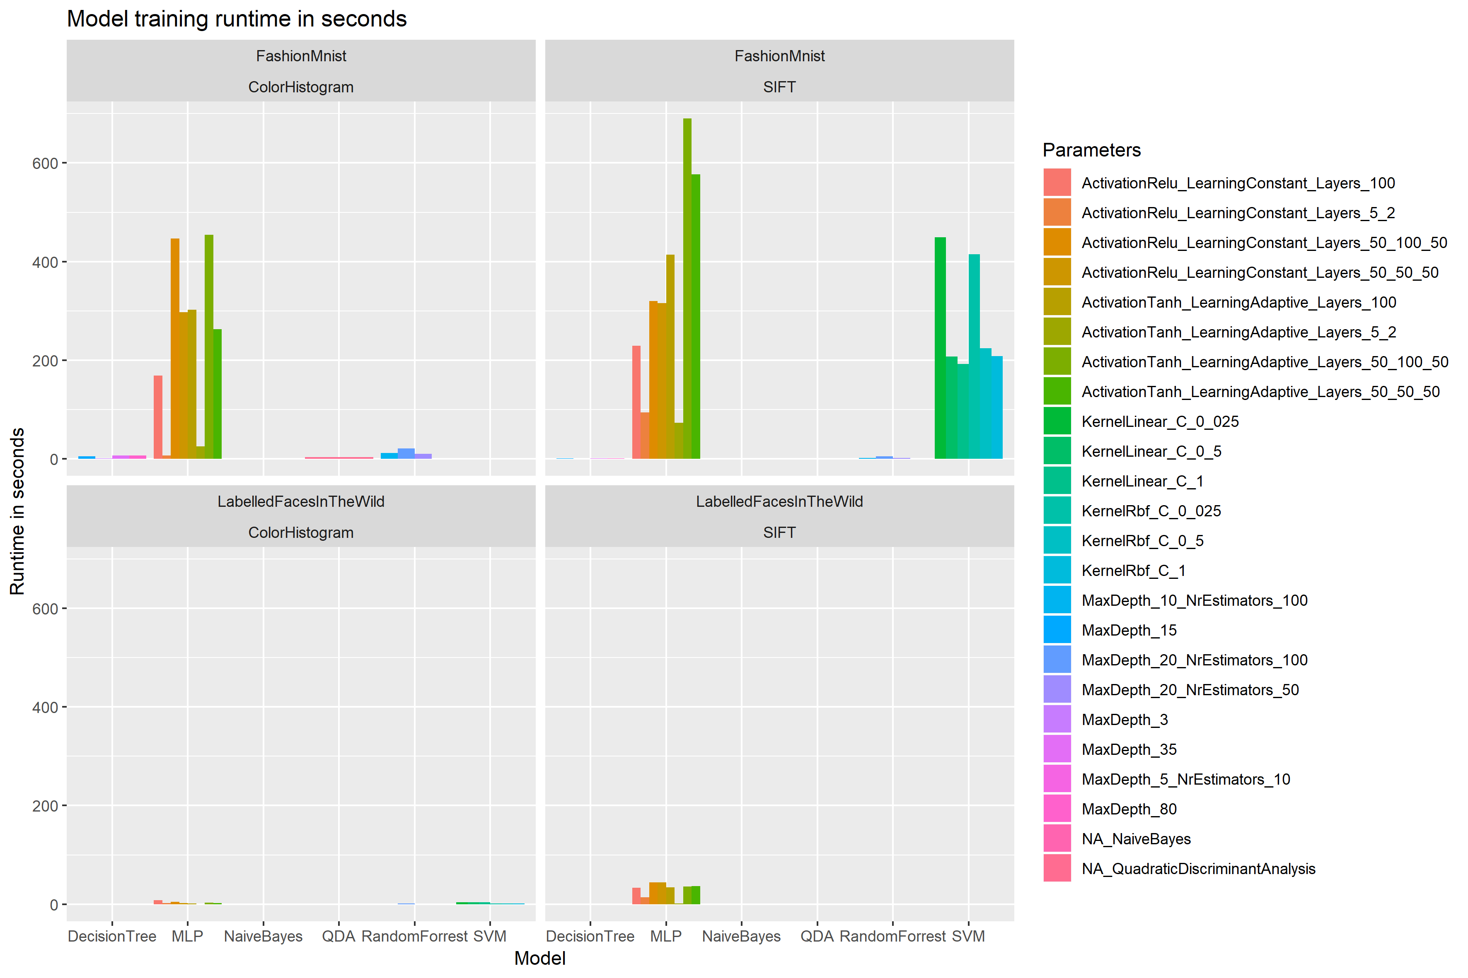
Time and Performance for Model Training

Slide 15
CNN Architectures
MiniVGGNet
MiniGoogLeNet

Slide 16
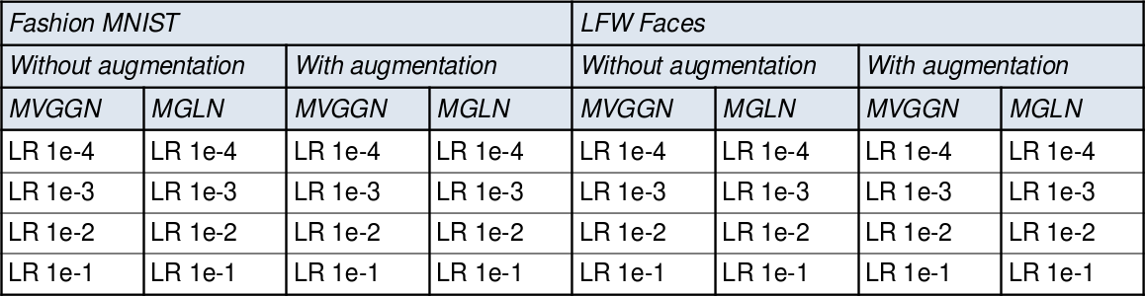
Setup

Slide 17
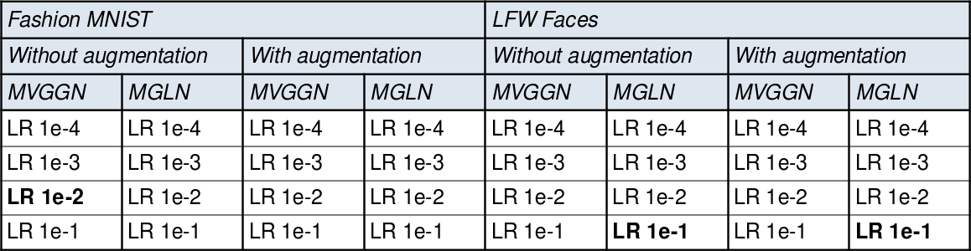




Setup
(Precision)
(Recall)
(F1)
(Precision)
(Recall)
(F1)
(Precision)
(Recall)
(F1)

Slide 18
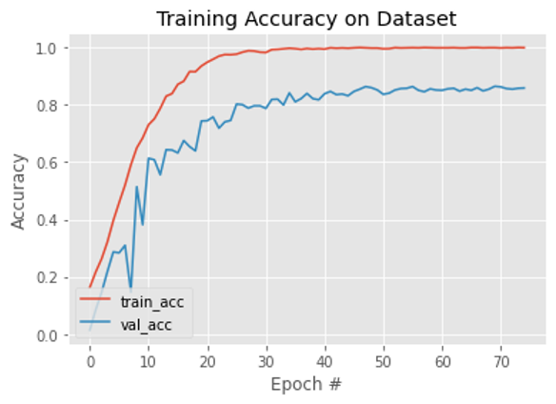
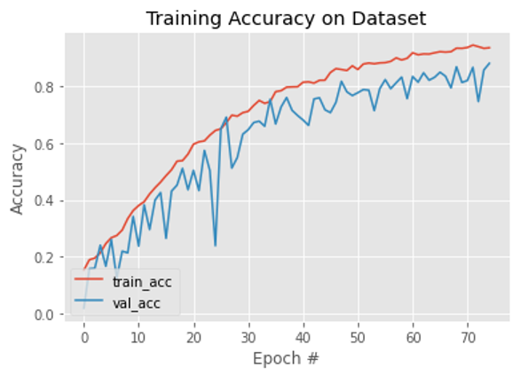
Augmentation and learning curves
Without augmentation
With augmentation

Slide 19
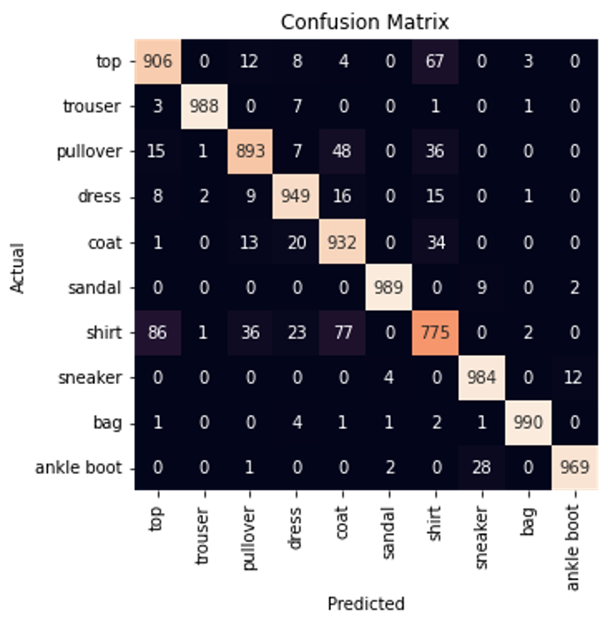
CNN – Fashion MNIST - MiniVGGNet

Slide 20
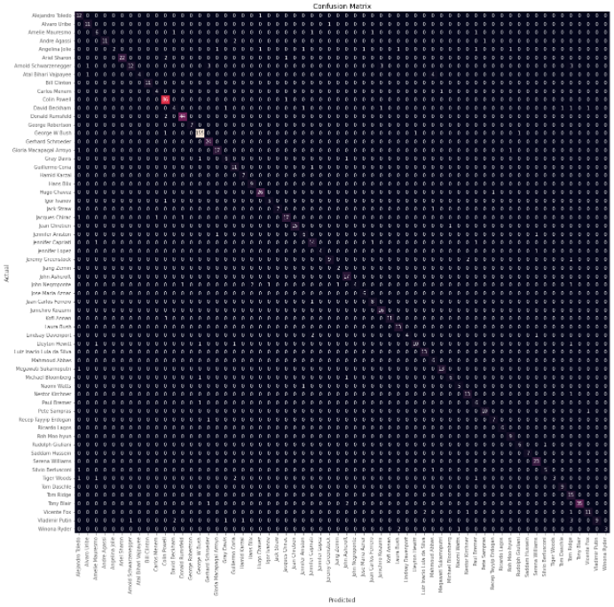
CNN – Labelled Faced in The Wild - MiniGoogLeNet

Slide 21
Conclusion
Color histograms:
Very fast runtime
Simple implementation
Considering simplicity, very good results
SIFT + BoVW:
More computation, but can be parallelized
Features can be controlled using Bag of Visual Words in K-means clustering
Implementation is more difficult, requires deeper understanding & knowledge
Superior results compared to color histograms

Slide 22
Conclusion
MiniVGGNet
More lightweight model
Outperformed with Fashion MNIST dataset
MiniGoogLeNet
More heavyweight model
Outperformed with LFW people dataset
Required minimum image size

Slide 23
Challenges and Limitations
Traditional:
SIFT approach often was not able to retrieve valuable information from image -> exception handling needed to loosen thresholds
MLP would not converge for smaller number of iterations (up to ~200), was set to 1000.
Computation of SVM took the longest among all methods
Deep learning:
Resource limitations
To get good results, long training was necessary
Difficulties setting seed for Keras

